Slide 1
DBMS MODULE – 1
Prepared by Mushtaq Ahmed D.M Assistant Professor,
Dept. of ISE

Slide 2
MODULE 1
INTRODUCTION TO DATABASES
OVERVIEW OF DATABASE LANGUAGES AND ARCHITECTURES
CONCEPTUAL DATA MODELLING USING ENTITIES AND RELATIONSHIPS

Slide 3
Basic Definitions
Database:
A collection of related data.
Data:
Known facts that can be recorded and have an implicit meaning.
Mini-world:
Some part of the real world about which data is stored in a database. For example, student grades and transcripts at a university.
Database Management System (DBMS):
A software package/ system to facilitate the creation and maintenance of a computerized database.
Database System:
The DBMS software together with the data itself. Sometimes, the applications are also included.

Slide 4
Defining a Database *Involves specifying the data types, structures, and constraints of the data to be stored in the database. * The database definition or descriptive information is also stored by the DBMS in the form of a database catalog or dictionary; it is called meta-data.
DATABASE MANAGEMENT SYSTEMS
The DBMS is a general-purpose software system that facilitates the processes of defining, constructing, manipulating, and sharing databases among various users and applications
Constructing the database * is the process of storing the data on some storage medium that is controlled by the DBMS
Manipulating a database
*Includes functions such as querying the database to retrieve specific data
* Updating the database to reflect changes in the miniworld
* reports from the data.
* Sharing a database allows multiple users and programs to access the database

Slide 5
An application program accesses the database by sending queries or requests for data to the DBMS A query typically causes some data to be retrieved
Transaction may cause some data to be read and some data to be written into the database
Other important functions provided by the DBMS include
*Protecting the database and maintaining it over a long period of time
Protection includes system protection against hardware or software malfunction (or
crashes) and security protection against unauthorized or malicious access.
* DBMS must be able to maintain the database system by allowing the system to evolve as
requirements change over time

Slide 6
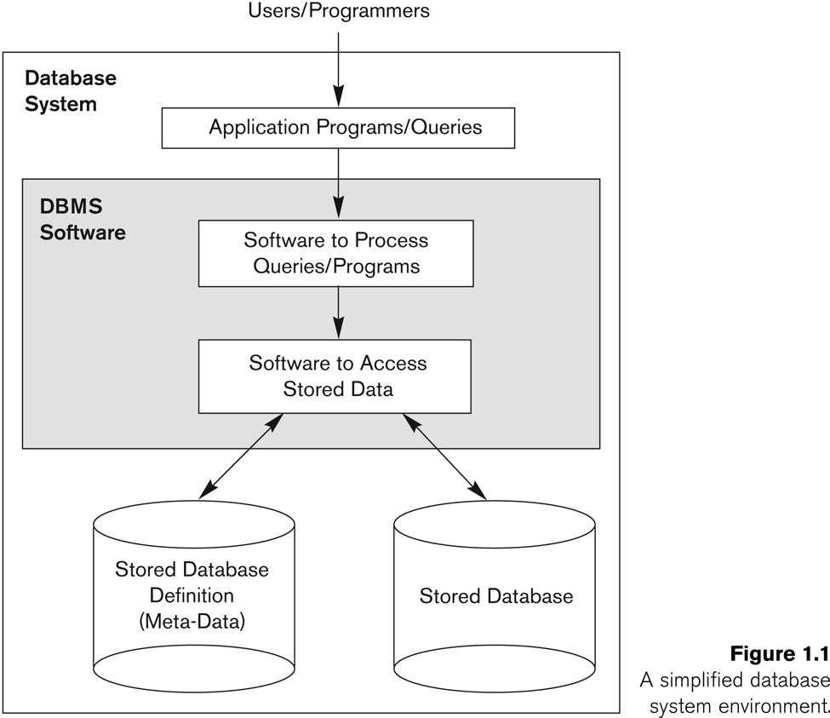
Simplified Database System Environment

Slide 7
Typical DBMS Functionality
Define a particular database in terms of its data types, structures, and constraints
Construct or Load the initial database contents on a secondary storage medium
Manipulating the database:
Retrieval: Querying, generating reports
Modification: Insertions, deletions and updates to its content
Accessing the database through Web applications
Processing and Sharing by a set of concurrent users and application programs – yet, keeping all data valid and consistent

Slide 8
Example of a Database (with a Conceptual Data Model)
Mini-world for the example:
Part of a UNIVERSITY environment.
Some mini-world entities:
STUDENTs
COURSEs
SECTIONs (of COURSEs)
(academic) DEPARTMENTs
INSTRUCTORs

Slide 9
Example of a Database (with a Conceptual Data Model)
Some mini-world relationships:
SECTIONs are of specific COURSEs
STUDENTs take SECTIONs
COURSEs have prerequisite COURSEs
INSTRUCTORs teach SECTIONs
COURSEs are offered by DEPARTMENTs
STUDENTs major in DEPARTMENTs
Note: The above entities and relationships are typically expressed in a conceptual data model, such as the ENTITY-RELATIONSHIP data mode

Slide 10
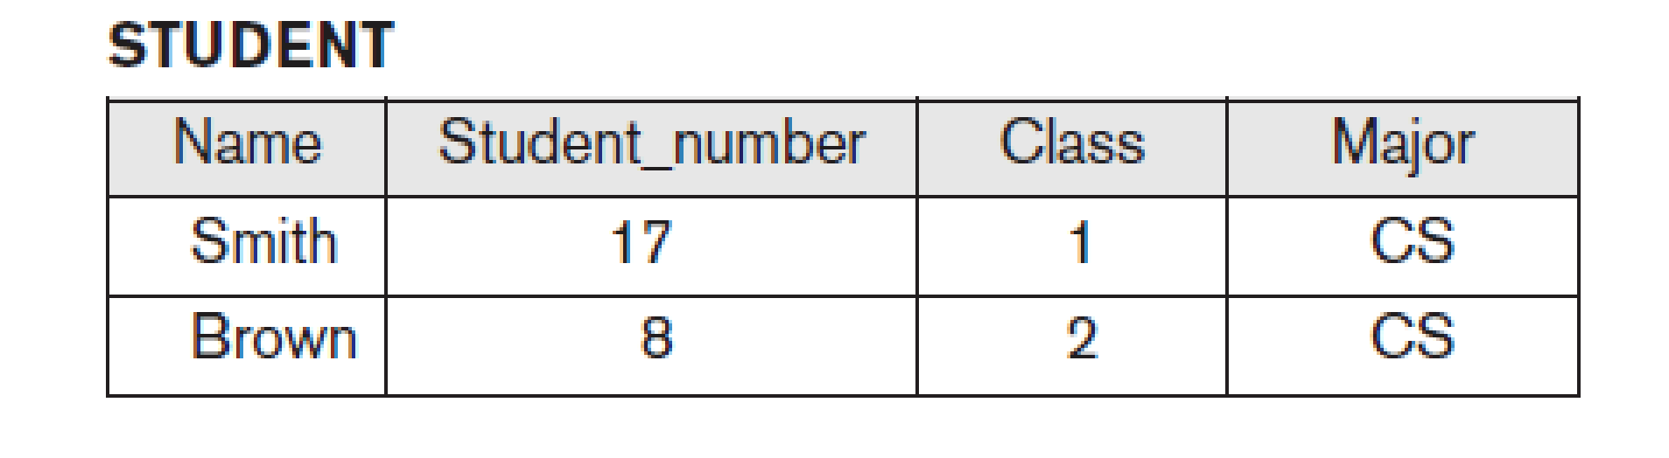

Example of a simple database
College Database
Student Entity Type
USN(KEY) | Name | Phone
Character(10) | Character(30) | integer
USN(KEY) | Name | Phone
1a | defg | 34567
1b | abc | 34434
1c | efg | 53475
Student Entity Type
EID(KEY) | Name | Phone
Character(20) | Character(40) | integer
Staff Entity Type
EID(KEY) | Name | Phone
2a | abc | 3575
2b | abc | 3575
2c | def | 4567
Staff Entity Type

Slide 11
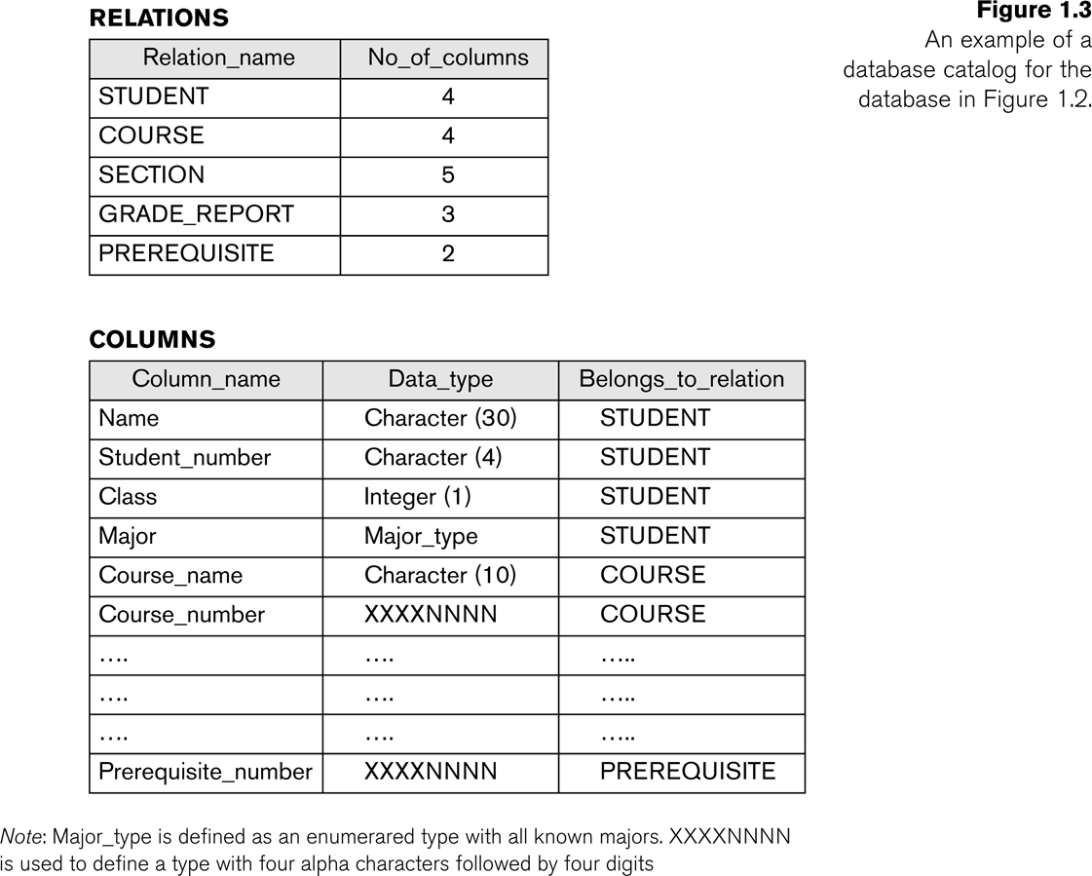
Example of a simplified database catalog
BACK

Slide 12
Main Characteristics of the Database Approach The main characteristics of the database approach versus the file-processing
Self-describing nature of a database system:
A DBMS catalog stores the description of the database. The description is called meta-data. This allows the DBMS software to work with different databases.
Insulation between programs and data:
Program – data independence
Allows changing data storage structures and operations without having to change the DBMS access programs.
Program – operation independence
User application programs can operate on the data by invoking operations through their names and parameters regardless how operations are implemented.

Slide 13
Main Characteristics of the Database Approach
Data Abstraction:
The characteristics that allows program – data independence and program – operation independence is called data abstraction.
A data model is used to hide storage details and present the users with a conceptual view of the database.
Support of multiple views of the data:
Each user may see a different view of the database, which describes only the data of interest to that user.
Sharing of data and multiuser transaction processing :
Allowing a set of concurrent users to retrieve and to update the database. Concurrency control within the DBMS guarantees that each transaction is correctly executed or completely aborted.
OLTP (Online Transaction Processing) is a major part of database applications

Slide 14
Differentiate between File System and DBMS
File System | DBMS
In traditional file processing, data definition is typically part of the application programs themselves. | A fundamental characteristic of the database approach is that the database system contains not only the database itself but also a complete definition or description of the database structure and constraints.
In traditional file processing, the structure of data files is embedded in the application programs, so any changes to the structure of a file may require changing all programs that access that file. | DBMS access programs do not require such changes in most cases. The structure of data files is stored in the DBMS catalog separately from the access programs.
Does not support multiple view of data | A database typically has many users, each of whom may require a different perspective or view of the database.
Concurrent access to the data in the file system has many problems like Reading the file while other deleting some information, updating some information etc. | DBMS takes care of Concurrent access using some form of locking.
.

Slide 15
Database Users
Database Users
Actors on the Scene
(actually use and control the content)
Workers Behind the Scene
(enable the database to be developed and the DBMS software to be designed and implemented)
Database administrators
Database Designers
End-users, System Analysts and Application Programmers(Software Engineers)
DBMS System Designers and Implementers
Tool Developers
Operators and Maintenance Personnel

Slide 16
Database Users
Actors on the Scene
Database administrators: responsible for authorizing access to the database, for co – ordinating and monitoring its use, acquiring software, and hardware resources, controlling its use and monitoring efficiency of operations.
Database Designers: responsible to define the content, the structure, the constraints, and functions or transactions against the database. They must communicate with the end-users and understand their needs.
End-users: they use the data for queries, reports and some of them actually update the database content.
System Analysts and Application Programmers(Software Engineers):
System Analyst determine the requirements of end users, especially Naïve and parametric end users and develop
specifications for canned transactions that meet these requirements.
Application Programmers implement these specifications as programs, then they test, debug, document and maintain
these canned transactions.

Slide 17
Categories of End-users
Casual : access database occasionally when needed, use query languages
Naive or Parametric : They use previously well-defined functions in the form of “canned transactions” against the database. Examples are bank-tellers or reservation clerks who do this activity for an entire shift of operations.
Sophisticated : these include business analysts, scientists, engineers, others thoroughly familiar with the system capabilities. Many use tools in the form of software packages that work closely with the stored database.
Stand-alone : mostly maintain personal databases using ready-to-use packaged applications. An example is a tax program user that creates his or her own internal database.

Slide 18
Database Users
Workers behind the scene
DBMS System Designers and Implementers
Design and implement the DBMS modules and interfaces as a software package
Tool Developers
Design and implement tools—the software packages that facilitate database modeling and
design, database system design, and improved performance ex: tools for performance
monitoring
Operators and Maintenance Personnel
(system administration personnel) are responsible for the actual running and maintenance of the hardware and software environment for the database system

Slide 19
Advantages of Using the Database Approach
Controlling redundancy in data storage and in development and maintenance efforts.
In file processing, every user group maintains its own files for handling its data-processing applications, many of the data being repeated(redundant)
This redundancy(controlled redundancy) in storing the same data multiple times leads to several problems
(i) Duplication of effort
(ii) Storage space is wasted
(iii) Inconsistent Data
Restricting unauthorized access to data
Provide a security and authorization subsystem, which the DBA uses to create accounts
and to specify account restrictions(privileged software)

Slide 20
Advantages of Using the Database Approach
Providing persistent storage for program Objects
The values of program variables or objects are discarded once a program terminates, unless the programmer explicitly stores them in permanent files
In this it can be stored permanently in an object-oriented DBMS.
Such an object is said to be persistent, since it survives the termination of program execution
Providing Storage Structures for efficient Query Processing
Provide capabilities for efficiently executing queries and updates
Provide specialized data structures and search techniques to speed up query execution
Query processing and optimization module of the DBMS is responsible for choosing an efficient query execution plan for each query based on the existing storage structures

Slide 21
Advantages of Using the Database Approach
Providing backup and recovery services
Backup and recovery subsystem provide facilities for recovering from hardware or software failures
Computer system fails in the middle of a complex update transaction, database to be restored to the state
it was in before the transaction started executing
Disk backup
Providing multiple interfaces to different classes of users
Provide a variety of user interfaces.
Ex: Query languages for casual users, Programming language interfaces for application programmers

Slide 22
Advantages of Using the Database Approach
Representing complex relationships among data
Represent a variety of complex relationships among the data
Ex: Brown
Enforcing integrity constraints on the database
Integrity constraints that must hold for the data
Ex: (i) Specifying a data type for each data item, USN character(25)
(ii) Referential integrity, each USN to be associated with Fee details
(iii) Key or uniqueness , USN can not be repeated
Permitting Inferencing and Actions using rules
Deductive database systems Ex: Determining Year Back students based on university rules
Active database/Triggers(a form of a rule activated by updates to the table) with tables Ex: Check if manager’s salary greater than person working under him, if so, send a message

Slide 23
Data Models
Data Model: A set of concepts to describe the structure of a database, and certain constraints that the database should obey.
Data Model Operations: Operations for specifying database retrievals and updates by referring to the concepts of the data model. Operations on the data model may include basic operations and user-defined operations
Categories of data models
Conceptual (high-level, semantic) data models
Provide concepts that are close to the way many users perceive data. (Also called entity-based or object-based data models.)
Physical (low-level, internal) data models
Provide concepts that describe details of how data is stored in the computer
iii Implementation (representational) data models
Provide concepts that fall between the above two, balancing user views with some computer storage details.

Slide 24
Schemas, Instances and Database State
Database Schema
The description of a database. Includes descriptions of the database structure and the constraints that should hold on the database.
Schema Diagram
A diagrammatic display of (some aspects of) a database schema.
Schema Construct
A component of the schema or an object within the schema, e.g., STUDENT, COURSE.
Database State
The actual data stored in a database at a particular moment in time. Also called snapshot or instance or
occurrence.
(i)Initial Database State: Refers to the database when it is loaded
(ii) Valid State: A state that satisfies the structure and constraints of the database.
(iii) Distinction:The database schema changes very infrequently. The database state changes every time the database is updated.
Schema is also called intension, whereas state is called extension.

Slide 25
Three-Schema Architecture
Proposed to support DBMS characteristics of
(i)Program-data independence.
(ii)Support of multiple views of the data.
Defines DBMS schemas at three levels:
Internal schema at the internal level to describe physical storage structures and access paths. Typically uses a physical data model.
Conceptual schema at the conceptual level to describe the structure and constraints for the whole database for a community of users. Uses a conceptual or an implementation data model.
External schemas at the external level to describe the various user views. Usually uses the same data model as the conceptual level.
Mappings among schema levels are needed to transform requests and data. Programs refer to an external schema, and are mapped by the DBMS to the internal schema for execution.

Slide 26
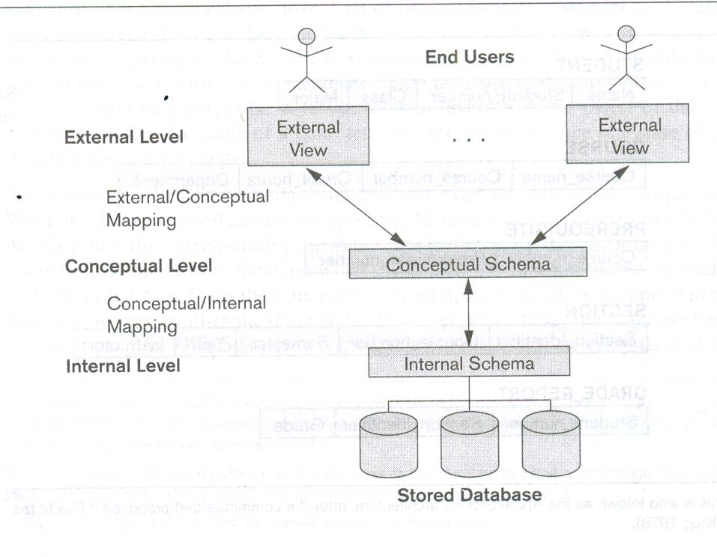
Three-Schema Architecture

Slide 27
Data Independence
The capacity to change the schema at one level of a database system without having to change the system at the next higher level.
Two types of data independences:
Logical Data Independence: The capacity to change the conceptual schema without having to change the external schemas and their application programs.
Physical Data Independence: The capacity to change the internal schema without having to change the conceptual schema.
When a schema at a lower level is changed, only the mappings between this schema and higher-level schemas need to be changed in a DBMS that fully supports data independence.
The higher-level schemas themselves are unchanged.
Hence, the application programs need not be changed since they refer to the external schemas.

Slide 28
Additional Implications of Using the Database Approach
Potential for enforcing standards:
This is very crucial for the success of database applications in large organizations Standards refer to data item names, display formats, screens, report structures, meta-data (description of data) etc.
Reduced application development time:
Incremental time to add each new application is reduced.
Flexibility to change data structures:
Database structure may evolve as new requirements are defined.
Availability of up-to-date information:
Very important for on-line transaction systems such as airline, hotel, car reservations.
Economies of scale:
By consolidating data and applications across departments wasteful overlap of resources and personnel can be avoided.

Slide 29
Brief History of Database Applications
Early Database Applications: The Hierarchical and Network Models were introduced in mid 1960’s and dominated during the seventies. A bulk of the worldwide database processing still occurs using these models.
Relational Model based Systems: The model that was originally introduced in 1970 was heavily researched and experimented with in IBM and the universities. Relational DBMS Products emerged in the 1980’s.
Object-oriented applications: OODBMSs were introduced in late 1980’s and early 1990’s to cater to the need of complex data processing in CAD and other applications. Their use has not taken off much.
Data on the Web and E-commerce Applications: Web contains data in HTML (Hypertext markup language) with links among pages. This has given rise to a new set of applications and E-commerce is using new standards like XML (eXtended Markup Language).

Slide 30
Extending Database Capabilities
New functionality is being added to DBMSs in the following areas:
Scientific Applications
Image Storage and Management
Audio and Video data management
Data Mining
Spatial data management
Time Series and Historical Data Management
The above gives rise to new research and development in incorporating new data types, complex data structures, new operations and storage and indexing schemes in database systems.

Slide 31
When not to use a DBMS
Main inhibitors (costs) of using a DBMS:
High initial investment and possible need for additional hardware.
Overhead for providing generality, security, concurrency control, recovery, and integrity functions.
When a DBMS may be unnecessary:
If the database and applications are simple, well defined, and not expected to change.
If there are stringent real-time requirements that may not be met because of DBMS overhead.
If access to data by multiple users is not required.
When no DBMS may suffice:
If the database system is not able to handle the complexity of data because of modeling limitations
If the database users need special operations not supported by the DBMS.

Slide 32
DBMS Languages
Data Definition Language (DDL): Used by the DBA and database designers to specify the conceptual schema of a database. In many DBMSs, the DDL is also used to define internal and external schemas (views). In some DBMSs, separate storage definition language (SDL) and view definition language (VDL) are used to define internal and external schemas.
Data Manipulation Language (DML): Used to specify database retrievals and updates.
DML commands (data sublanguage) can be embedded in a general-purpose programming language (host language), such as COBOL, C or an Assembly Language.
Alternatively, stand-alone DML commands can be applied directly (query language).
Types of DML:
High Level or Non-procedural DML: e.g., SQL, are set-oriented and specify what data to retrieve than how to retrieve. Also called declarative languages.
Low Level or Procedural DML: record-at-a-time; they specify how to retrieve data and include constructs such as looping.

Slide 33
DBMS Interfaces
* Stand-alone query language interfaces.
* Programmer interfaces for embedding DML in programming languages
* User-friendly interfaces:
Menu-based, popular for browsing on the web
Forms-based, designed for naïve users
Graphics-based (Point and Click, Drag and Drop etc.)
Natural language: requests in written English
Speech as Input and Output
Web Browser as an interface
Parametric interfaces (e.g., bank tellers) using function keys.
Interfaces for the DBA:
Creating accounts, granting authorizations
Setting system parameters
Changing schemas or access path

Slide 34
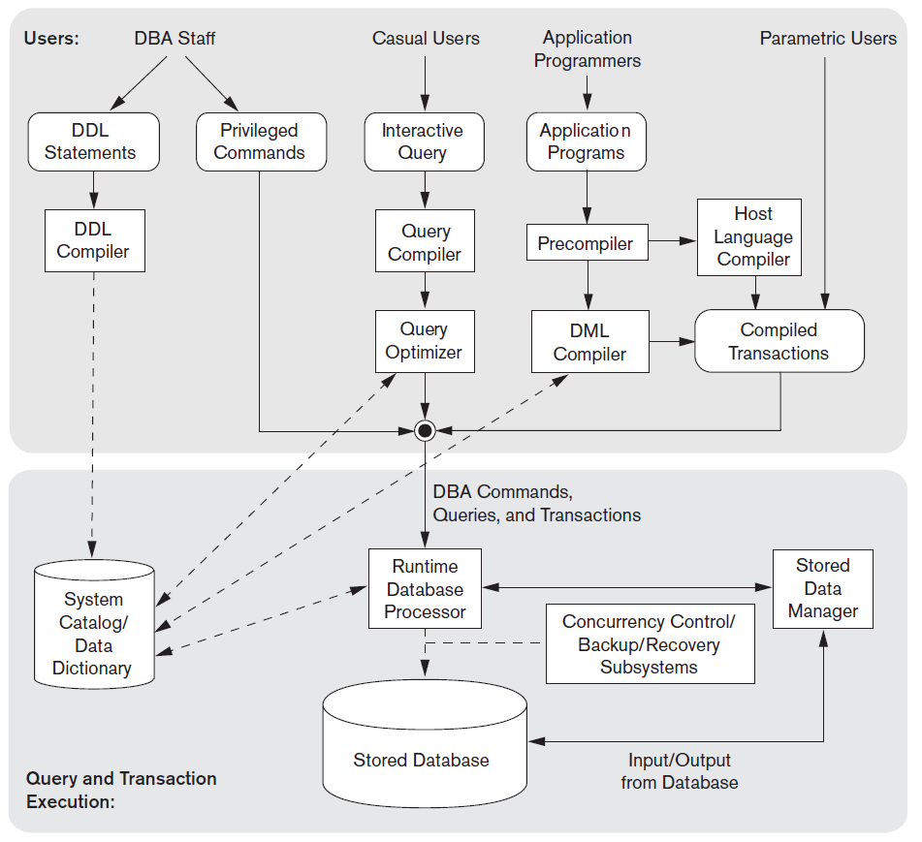
DBMS Component Modules

Slide 35
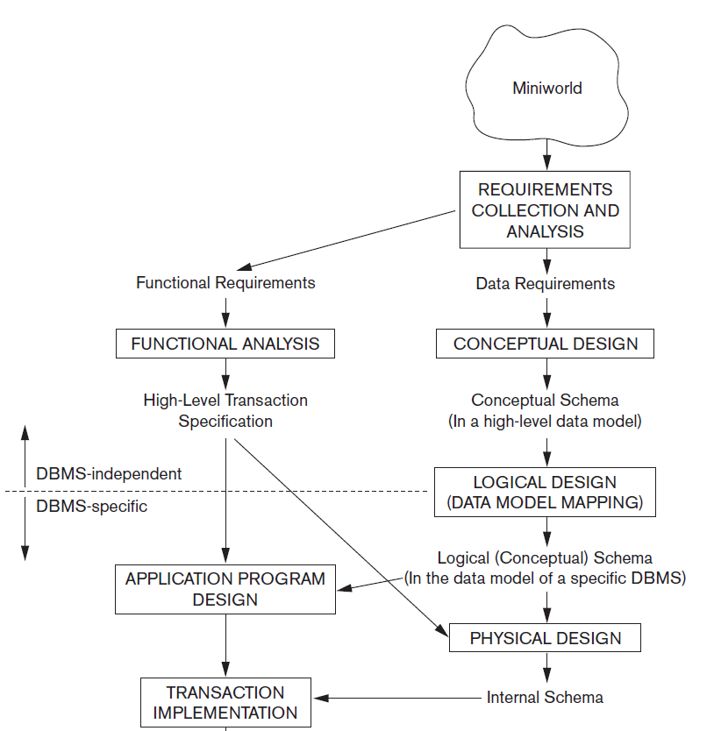

Using High – Level Conceptual Data Models for Database Design

Slide 36
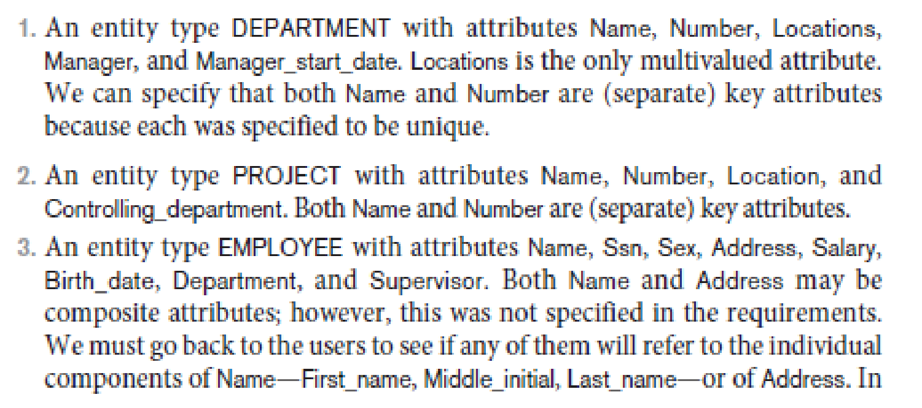
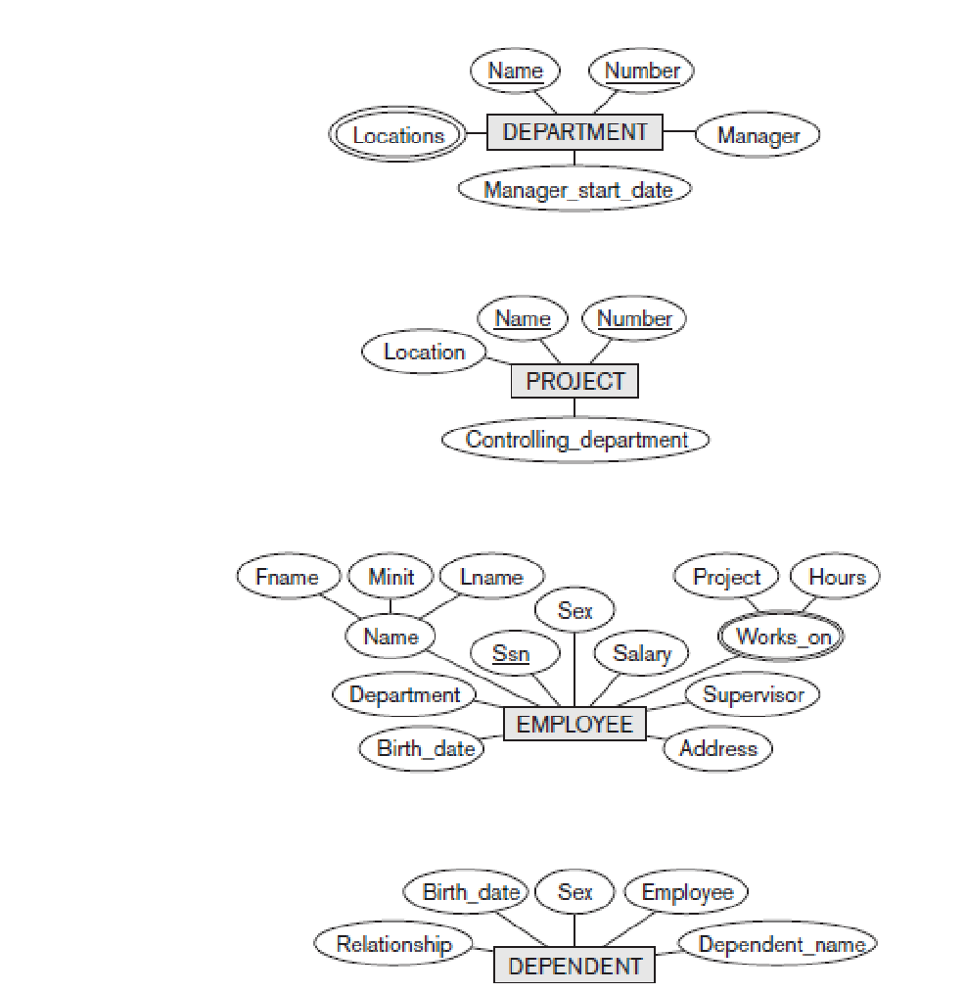
An Example Database Application

Slide 37
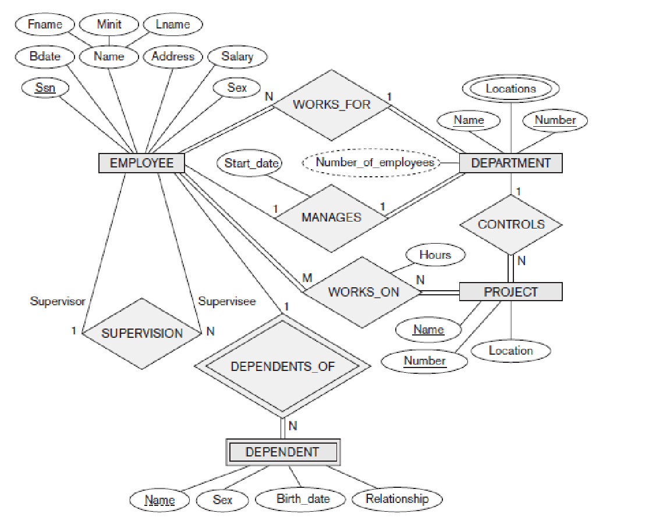

Slide 38
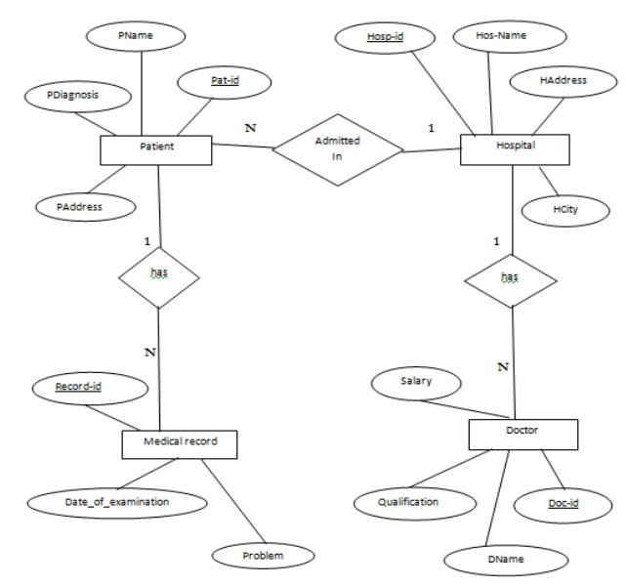
Hospital Management System

Slide 39
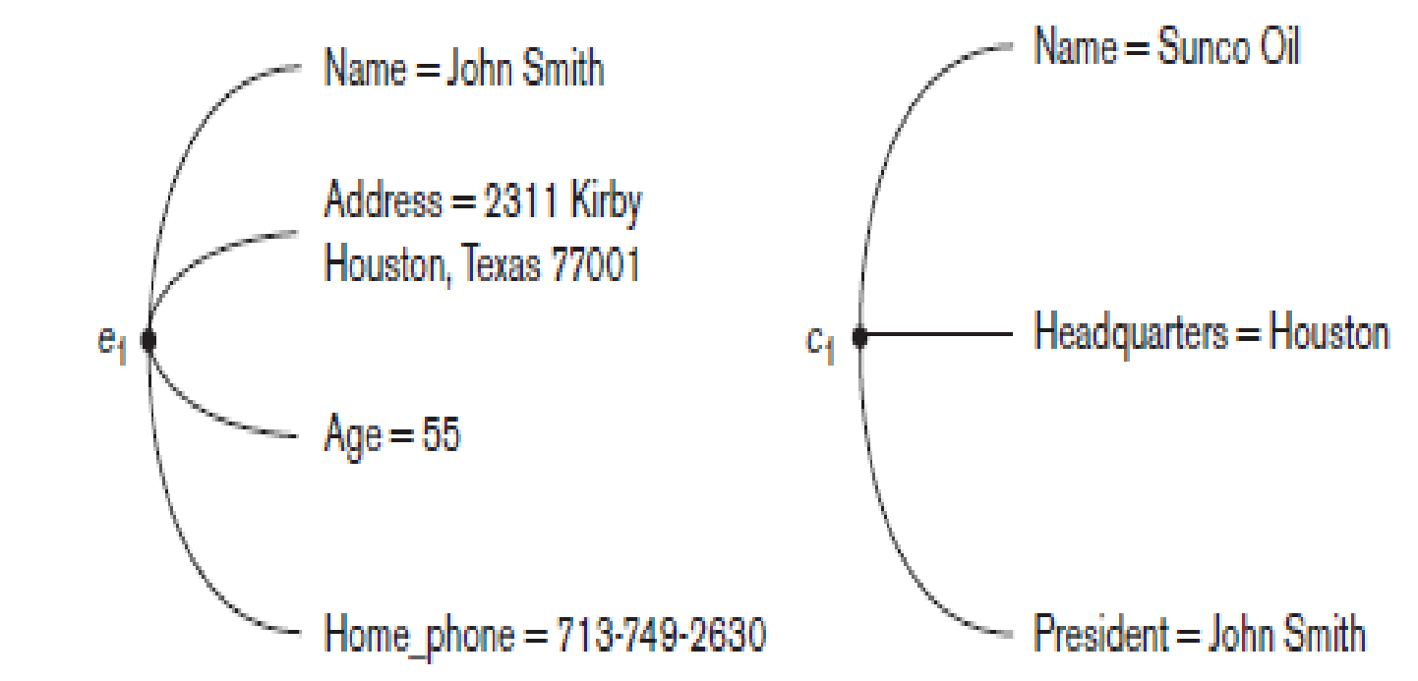
Entity Types, Entity Sets, Attributes and Keys
Entity
A thing in the real world with an independent existence.
Eg: A particular person, Car, House or an Employee
Attribute
The particular property that describes the entity.
Eg: An Employee’s name, age, address, salary and job
Types of Attributes
(i)Composite versus simple(Atomic) Attributes
(ii)Single Valued versus Multivalued Attributes
(iii)Stored versus Derived Attributes
(iv) Complex Attributes
For example, {Address_phone({Phone(Area_Code, Phone_Number)},
Address(Street_Address (Number, Street, Apartment_Number), City, Zip_Code))
(v) Null Values

Slide 40
Entity Types
A collection of entities that have the same attributes.
Each entity type in the database is described by its name and attributes.
An entity type describes the schema or intension for a set of entities that share the same structure.
Eg: EMPLOYEE and COMPANY and a list of attributes for each.
An entity type is represented in ER diagrams as a rectangular box enclosing the entity type name.

Slide 41
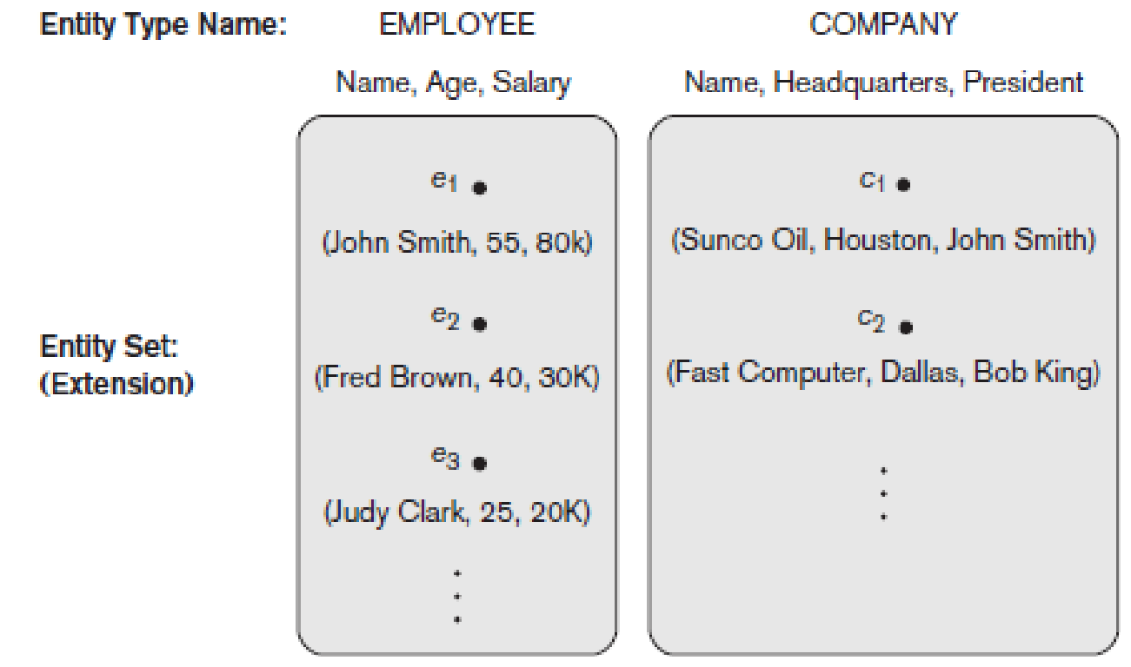
Entity Set
The collection of entities of a particular entity type is grouped into an entity set.
This is also called as Extension of the entity type.

Slide 42
ENTITY SET corresponding to the ENTITY TYPE CAR
Entity Type
CAR
Registration(RegistrationNumber, State), VehicleID, Make, Model, Year, (Color)
car₁
((ABC 123, TEXAS), TK629, Ford Mustang, convertible, 1999, (red, black))
car₂
((ABC 123, NEW YORK), WP9872, Nissan 300ZX, 2-door, 2002, (blue))
car₃
((VSY 720, TEXAS), TD729, Buick LeSabre, 4-door, 2003, (white, blue))
.
.
.
Entity Set

Slide 43
Key Attribute of an Entity Type
An entity type usually has an attribute whose values are distinct for each individual entity in the entity set.
Such an attribute is called as key attribute and its values can be used to identify each entity uniquely.
Eg: No two companies will have the same name, so name attribute is the key attribute in COMPANY.
In ER diagrammatic notation, each key attribute has its name underlined inside the oval.

Slide 44
Value Sets (Domains) of Attributes
Each simple attribute of an entity type is associated with a value set (or domain of values), which specifies the set of values that may be assigned to that attribute for each individual entity.
Value sets are typically specified using the basic data types.
Ex: If the range of ages allowed for employees is between 16 and 70, we can specify the value set of the Age attribute of EMPLOYEE to be the set of integer numbers between 16 and 70.
We can specify the value set for the Name attribute to be the set of strings of alphabetic characters separated by blank characters, and so on.

Slide 45
Relationship Types, Relationship Sets, and Instances
A relationship type R among n entity types E₁, E₂, … E_{n} defines a set of associations – or a relationship set – among entities from these entity types.
Mathematically, the relationship set R is a set of relationship instances r_{i}, where each r_{i} associates n individual entities(e₁,e_{2,…,}e_{n)} and each entity e_{j} in r_{i} is a member of entity set E_{j}, 1 ≤ j ≤ n.

Slide 46
Example 1…
EMPLOYEE
WORKS_FOR
DEPARTMENT
e_{1 }
e_{2 }
e_{3 }
e_{4 }
e_{5 }
e_{6 }
e_{7 }
r₁
r₂
r₃
r₄
r₅
r₆
r₇
● d₁
● d₂
● d₃

Slide 47
Example 2…
EMPLOYEE WORKS_ON PROJECT
e_{1 }
e_{2 }
e_{3 }
e_{4 }
e_{5 }
e_{6 }
e_{7 }
r₉
● p₁
● p₂
● p₃
r₁
r₂
r₃
r₄
r₅
r₆
r₇
r₈

Slide 48
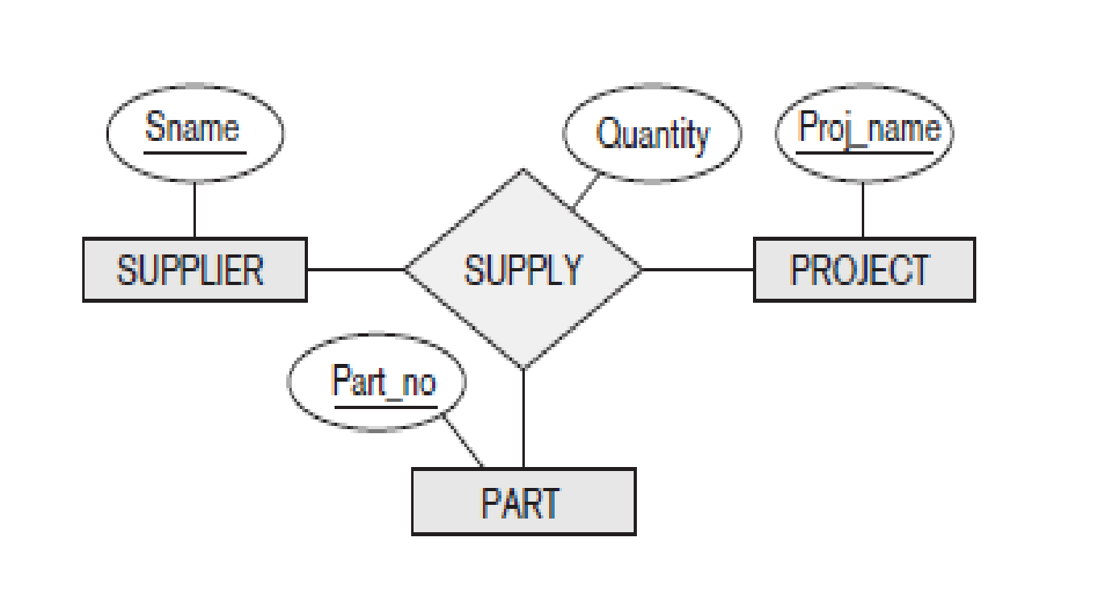
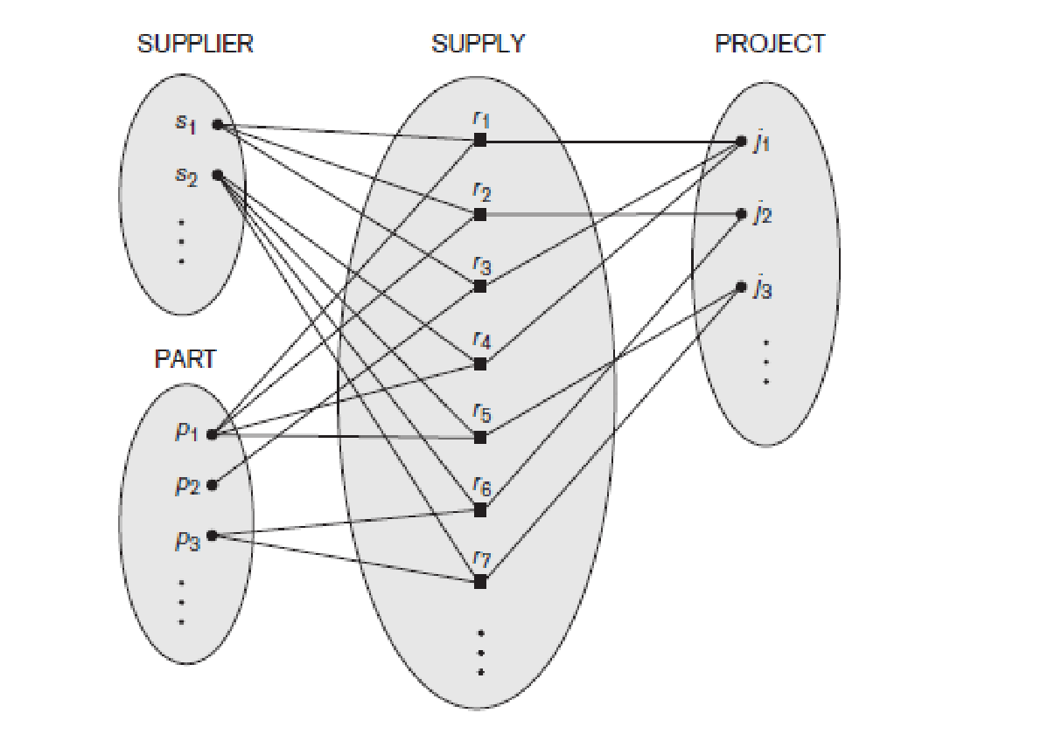
Relationship Degree
The degree of a relationship type is the number of participating entity types.
A relationship type of degree two is called binary, and one of degree three is called ternary.

Slide 49
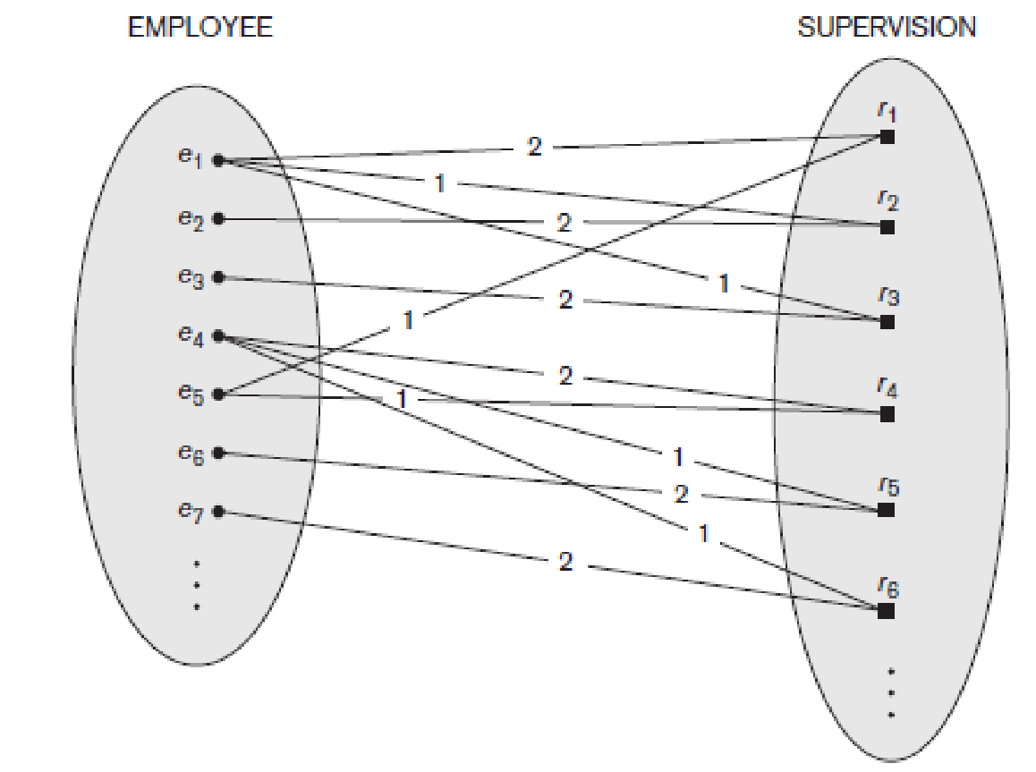
Role Names and Recursive Relationships
Each entity type that participates in a relationship type plays a particular role in the relationship.
The role name signifies the role that a participating entity from the entity type plays in each relationship instance, and helps to explain what the relationship means.
Some entity types participates more than once in a relationship type in different roles. Such relationship types are called recursive relationships.
1-Supervisor
2-Supervisee

Slide 50
Example…
EMPLOYEE
SUPERVISION
e_{1 }
e_{2 }
e_{3 }
e_{4 }
e_{5 }
e_{6 }
e_{7 }
r₁
r₂
r₃
r₄
r₅
r₆
2
1
1
2
2
1
2
1
1
2
1
2
Supervisor Role
Subordinate Role

Slide 51
Constraints on Binary Relationship Types
There are two types of relationship constraints:
Cardinality ratio:
* The cardinality ratio for binary relationship specifies the maximum number of relationship instances that an entity can participate in.
* The possible cardinality ratio for binary relationship types are 1:1, 1:N, N:1 and M:N
Participation:
* The participation constraint specifies whether the existence of an entity depends on its being related to another entity via the relationship type.
* This constraint specifies the minimum number of relationship instances that each entity can participate in.
The cardinality ratio and participation constraint together called as structural constraint.

Slide 52
1:1 Relationship
EMPLOYEE
MANAGES
DEPARTMENT
e_{1 }
e_{2 }
e_{3 }
e_{4 }
e_{5 }
e_{6 }
e_{7 }
r₁
r₂
r₃
.
.
.
● d₁
● d₂
● d₃

Slide 53
1:N Relationship
EMPLOYEE
WORKS_FOR
DEPARTMENT
e_{1 }
e_{2 }
e_{3 }
e_{4 }
e_{5 }
e_{6 }
e_{7 }
r₁
r₂
r₃
r₄
r₅
r₆
r₇
● d₁
● d₂
● d₃

Slide 54
M:N Relationship
EMPLOYEE WORKS_ON PROJECT
r₁
r₂
r₃
r₄
r₅
r₆
r₇
e_{1 }
e_{2 }
e_{3 }
e_{4 }
e_{5 }
e_{6 }
e_{7 }
r₉
● p₁
● p₂
● p₃
r₈

Slide 55
Participation Constraint and Existence Dependence
The participation constraint specifies whether the existence of an entity depends on its being related to another entity via the relationship type.
This constraint specifies the minimum number of relationship instances that each entity can participate in and is sometimes called the minimum cardinality constraint.
Two types of participation constraint:
Total Participation, also called as Existence Dependency-If a company policy states that every employee must work for a department, then an employee entity can exist only if it participates in at least one WORKS_FOR relationship instance
Partial Participation-we do not expect every employee to manage a department, so the participation of EMPLOYEE in the MANAGES relationship type is partial, meaning that some or part of the set of employee entities are related to some department entity via MANAGES, but not necessarily all.

Slide 56
Total Participation, also called as Existence Dependency
EMPLOYEE
WORKS_FOR
DEPARTMENT
e_{1 }
e_{2 }
e_{3 }
e_{4 }
e_{5 }
e_{6 }
e_{7 }
r₁
r₂
r₃
r₄
r₅
r₆
r₇
● d₁
● d₂
● d₃

Slide 57
1:1 Relationship
EMPLOYEE
MANAGES
DEPARTMENT
e_{1 }
e_{2 }
e_{3 }
e_{4 }
e_{5 }
e_{6 }
e_{7 }
r₁
r₂
r₃
.
.
.
● d₁
● d₂
● d₃

Slide 58
Attributes as Relationship Types
A relationship type can have attributes; for example, HoursPerWeek of WORKS_ON; its value for each relationship instance describes the number of hours per week that an EMPLOYEE works on a PROJECT.

Slide 59
Weak Entity Types
Entity types that do not have key attributes of their own are called weak entity types.
The entity types which contain key attributes of their own are called regular entity types or strong entity types.
Entities belonging to weak entity type are identified by being related to specific entities from another entity type in combination with one of their attribute values. This other entity type is called as identifying entity type or owner entity type.
The relationship type that relates a weak entity type to its owner is called as identifying relationship of the weak entity type.
The weak entity type normally has a partial key, which is the set of attributes that can uniquely identify weak entities that are related to the same owner entity.

Slide 60
Example…
Example:
Suppose that a DEPENDENT entity is identified by the dependent’s first name and birth date, and the specific EMPLOYEE that the dependent is related to.
DEPENDENT is a weak entity type with EMPLOYEE as its identifying entity type via the identifying relationship type DEPENDENT_OF.

Slide 61
Notations Used in ER Diagrams
Symbol
Meaning
ENTITY TYPE
WEAK ENTITY TYPE
RELATIONSHIP TYPE
IDENTIFYING RELATIONSHIP TYPE
ATTRIBUTE
KEY ATTRIBUTE
MULTIVALUED ATTRIBUTE
COMPOSITE ATTRIBUTE
DERIVED ATTRIBUTE
TOTAL PARTICIPATION OF E₂ IN R
CARDINALITY RATIO 1:N FOR E₁:E₂ IN R
STRUCTURAL CONSTRAINT (min, max) ON PARTICIPATION OF E IN R
E₁
R
E₂
E₁
1
R
N
E₂
R
(min,max)
E

Slide 62
Proper Naming of Schema Constructs
Use singular names for entity types, rather than plural one.
Verbs tend to indicate the relationship types.
Another naming consideration involves choosing the binary relationship names to make the ER diagram of the schema readable from left to right and top to bottom.

Slide 63
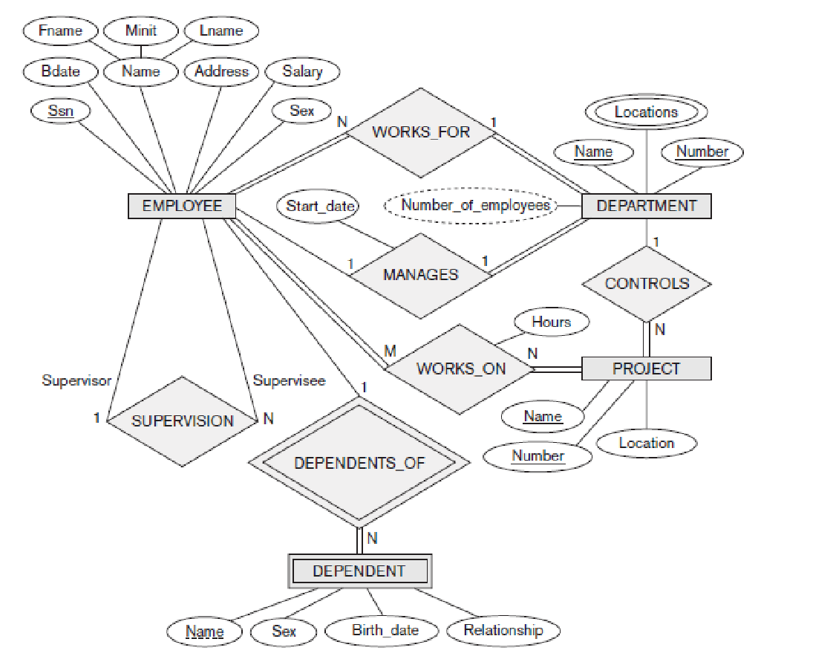
E – R Diagram for COMPANY

Slide 64
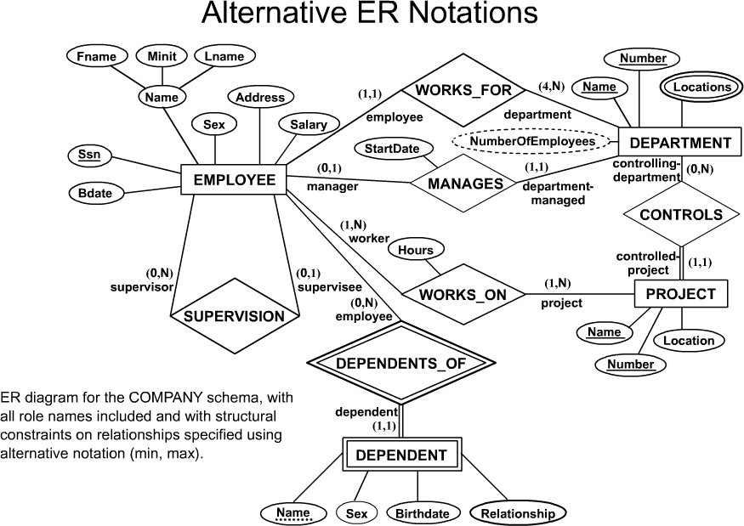
Alternative Notations for ER Diagrams

